Slide 1




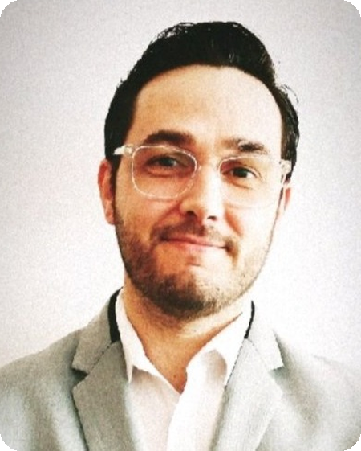
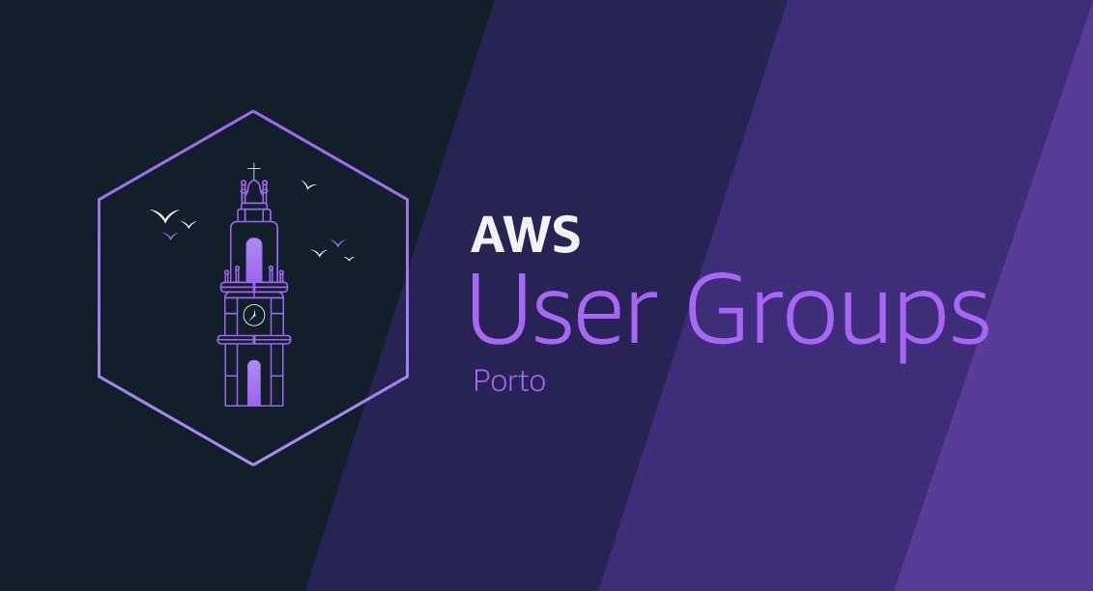
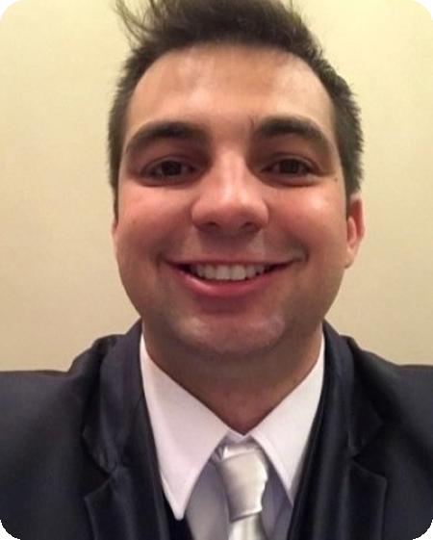
What is technical management in OutSystems
Ricardo Pereira
OutSystems Factory Manager | Tech Lead
#8
AWS UG Porto x
OutSystems UG Porto
Building a Modern Event-Driven Data Platform with AWS & Snowflake
Rafael Arruda
Sep 8th | 6:30 PM | Porto
Data Engineer at Best in Bi Solutions
Vertical Dom Henrique · VA Coworking · R. do Bolhão, Porto

Slide 2
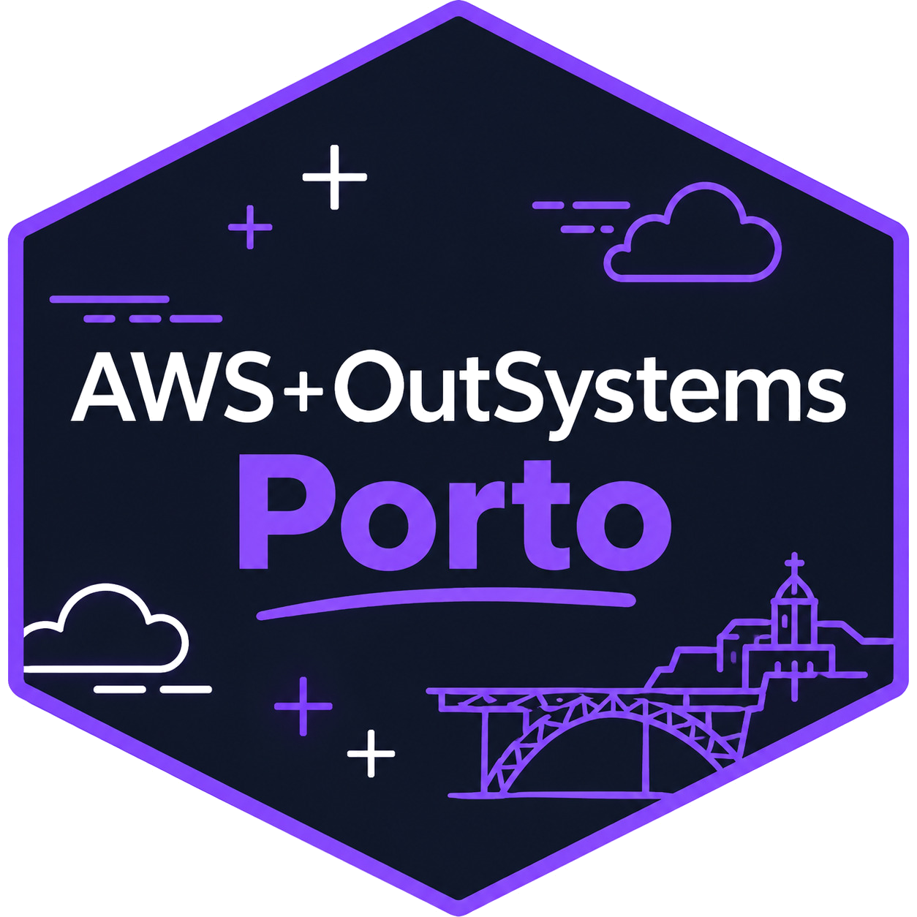
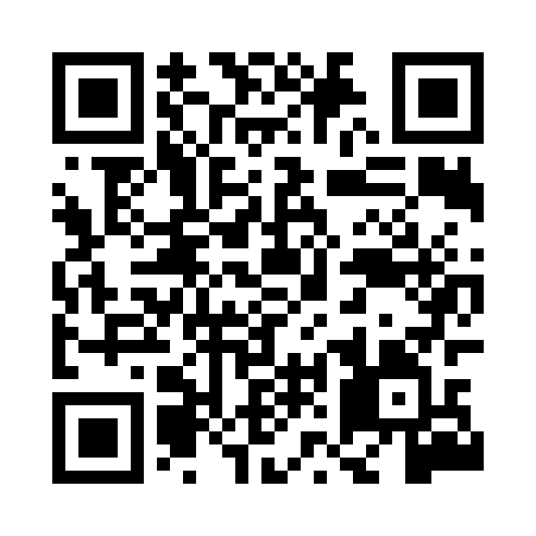
About AWS User Group Porto
• Official AWS User Group in Porto, founded in 2016
• 391 members on Meetup and a 4.81★ average event rating
• Cloud computing, DevOps, AI/ML, serverless, security and beyond
• Meetups, workshops and hands-on sessions on AWS best practices
• #8 edition: our first joint meetup with OutSystems User Group Porto
Join us on Meetup
Your community for AWS & Cloud Technology in Porto
“Two communities that rarely share a stage, together for one evening.”
AWS User Group Porto × OutSystems User Group Porto · #8 · 8 September 2026
2 / 9

Slide 3
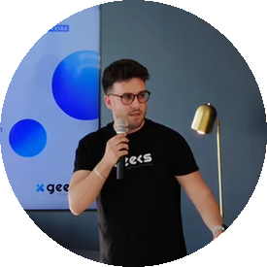
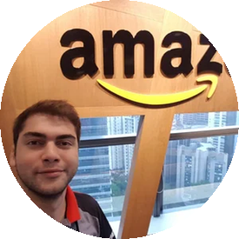
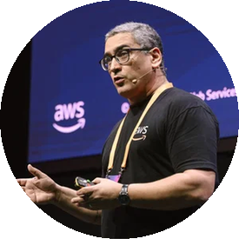

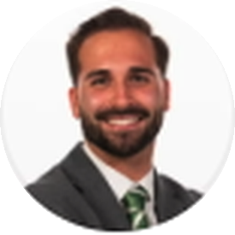
Our Leadership Team
Fábio Sampaio
Gabriel Alves
Luiz Rodrigues
Tiago Rodrigues
Ivan Ferreira
Organizer
Organizer
Organizer
Organizer
Event Organizer
Hosting tonight
Hosting tonight
Hosting tonight
Come say hi during the break: feedback, talk ideas and venue offers are always welcome.
AWS User Group Porto × OutSystems User Group Porto · #8 · 8 September 2026
3 / 9

Slide 4
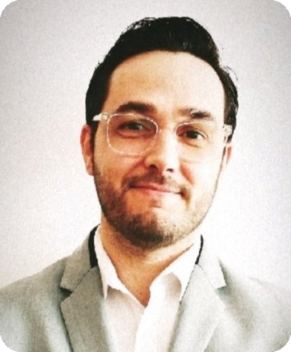
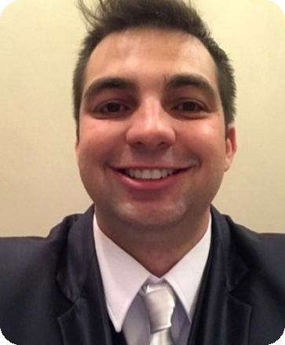
Speakers & Talks
TALK 1
Ricardo Pereira
What is technical management in OutSystems
OutSystems Factory Manager | Tech Lead
Faster development also means failing faster. Keeping an OutSystems ecosystem healthy, with sustainable technical debt and room to scale, takes deliberate technical leadership: implementation guidelines grounded in best practices, centers of excellence, and continuous training for everyone contributing to the ecosystem.
TALK 2
Rafael Arruda
Building a Modern Event-Driven Data Platform with AWS & Snowflake
Data Engineer at Best in Bi Solutions
A real-world architecture for a customer that needed fresh data every 2 to 5 minutes: an event-driven flow where the only scheduled component is the extraction from the source API. EventBridge, Lambda, Amazon S3 and SNS integrate with Snowflake through Snowpipe Streaming and Dynamic Tables, with the decisions, trade-offs and lessons learned in production.
AWS User Group Porto × OutSystems User Group Porto · #8 · 8 September 2026
4 / 9

Slide 5
Agenda
18:30
Check-in & Networking
19:00
Welcome & Intros
AWS User Group Porto, OutSystems User Group Porto & Partners
Talk 1
What is technical management in OutSystems
Ricardo Pereira · OutSystems Factory Manager | Tech Lead
Talk 2
Building a Modern Event-Driven Data Platform with AWS & Snowflake
Rafael Arruda · Data Engineer at Best in Bi Solutions
20:30+
Catering, drinks & community networking
KCD Porto ticket raffle: the winner is drawn at the end of the meetup
AWS User Group Porto × OutSystems User Group Porto · #8 · 8 September 2026
5 / 9

Slide 6
Sponsors & Meetup Partner
SPONSORS
MEETUP PARTNER
Venue sponsor
Main sponsor
Meetup partner
VA Coworking · Vertical Dom Henrique, Porto
synvert xgeeks · continuous support of the community
OutSystems User Group Porto
A huge thank you to VA Coworking for hosting us, synvert xgeeks for the continuous support, and to OutSystems User Group Porto for making this joint edition happen!
AWS User Group Porto × OutSystems User Group Porto · #8 · 8 September 2026
6 / 9

Slide 7

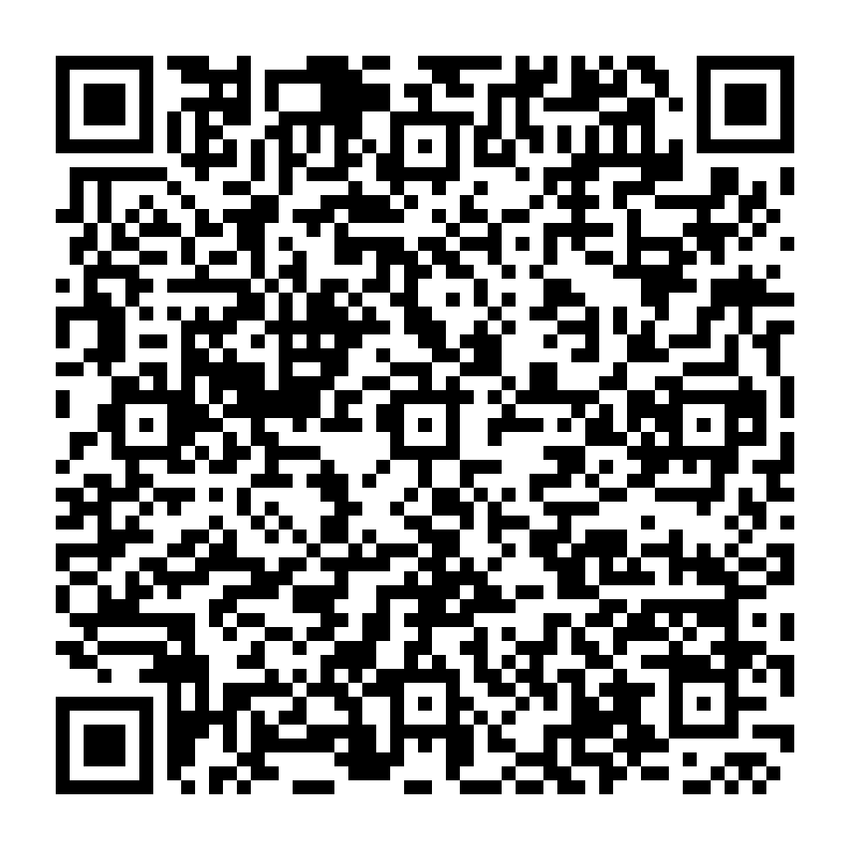
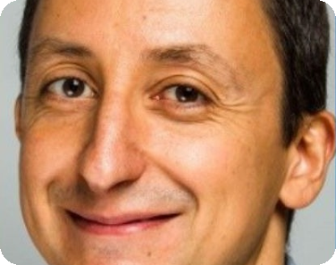
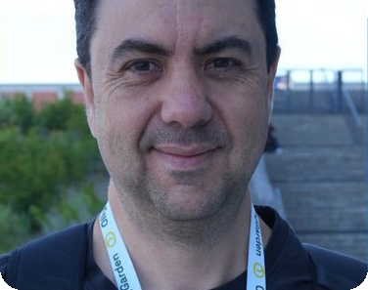
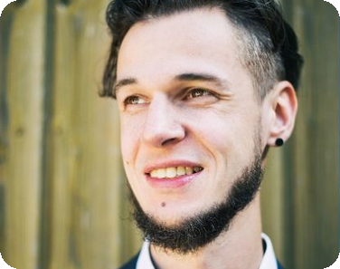
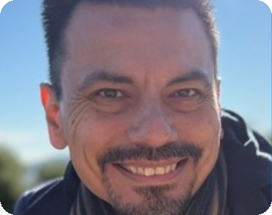
KCD Porto × DevOps Days Portugal
KCD Porto 2026 | Collab with DevOps Days Portugal
19–20 November 2026
SuperBock Arena – Pavilhão Rosa Mota, Porto
The biggest Kubernetes and Cloud Native event ever organized in Portugal: two days, 500+ attendees, keynotes, technical sessions and networking.
CONFIRMED KEYNOTES
Scan for tickets & info
10% off
Manuel Pais
Juraci Paixão
Mario Fahlandt
Natanael Copa
WITH DISCOUNT CODE
Team Topologies Co-Author
CEO of OllyGarden
Customer Delivery Architect at Kubermatic
Creator of Alpine Linux · k0s Maintainer
cnpdevopsdiscount
Full agenda released this week
10% off tickets at checkout on the KCD Porto event page
AWS User Group Porto × OutSystems User Group Porto · #8 · 8 September 2026
7 / 9

Slide 8
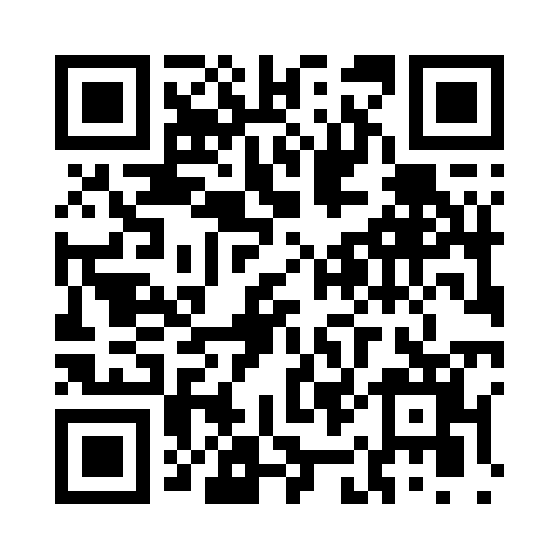
Raffle: win a KCD Porto ticket
We are raffling one KCD Porto × DevOps Days Portugal ticket at this meetup.
Scan the QR code, fill in the form, and the winner is drawn at the end of the meetup.
forms.gle/mBZbHRNYxwsuqphm6
Scan to enter the raffle
AWS User Group Porto × OutSystems User Group Porto · #8 · 8 September 2026
8 / 9

Slide 9




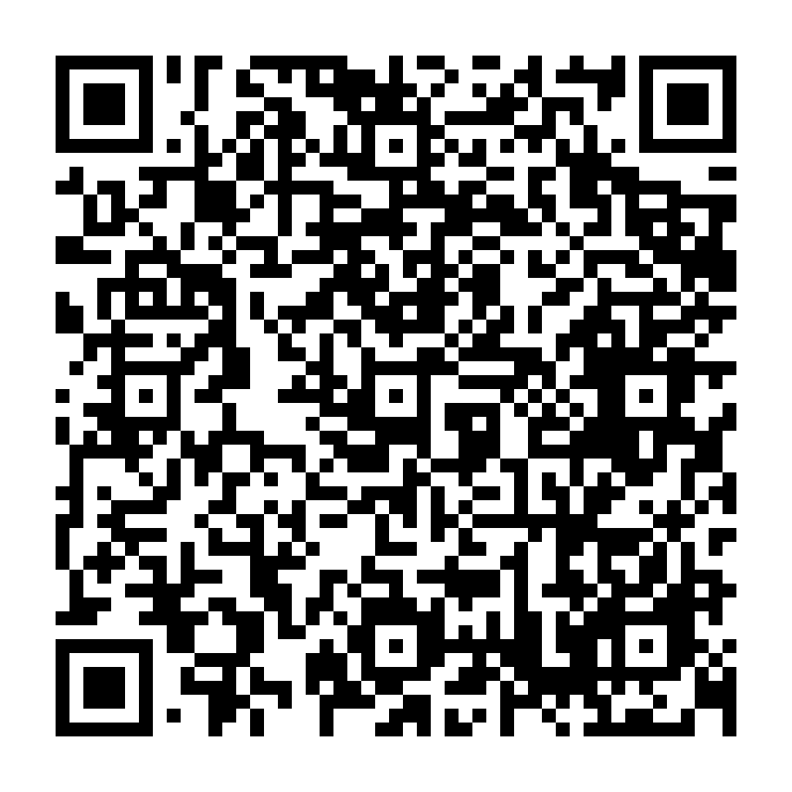
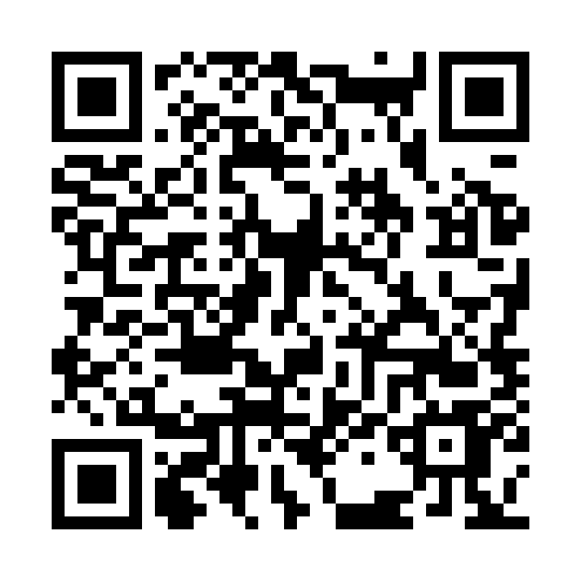
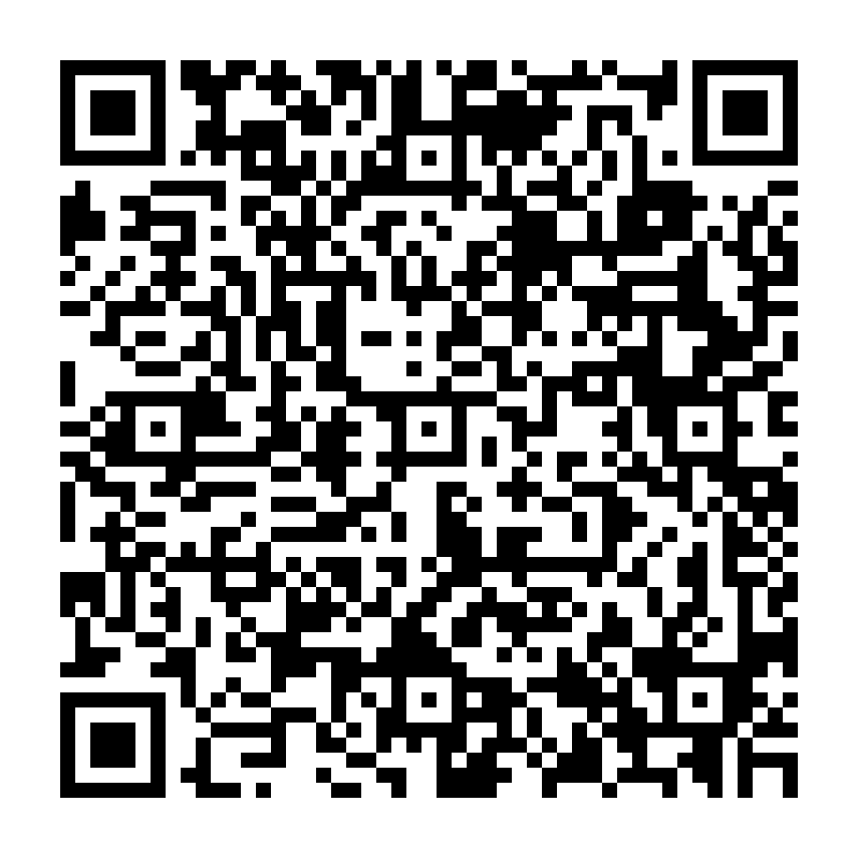
Thank you!
Hope you enjoyed your time with us. See you at KCD Porto × DevOps Days Portugal on 19–20 November!
COLLABORATE AND FOLLOW US
Slack · AWS User Group Portugal
Meetup · AWS User Group Porto
LinkedIn · AWS User Group Porto
Call for speakers
join.slack.com · awsusergroupportugal
meetup.com/aws-porto-user-group
linkedin.com/company/aws-user-group-porto
Submit a talk for a future meetup
AWS User Group Porto × OutSystems User Group Porto · #8 · 8 September 2026
9 / 9

